Slide 1

The Fox Islands Wind Project
Presented By: PJM6005 Group 2
John DiSessa
Nanique Gheridian
Dominique Hite
Notes:
The Scope Management process for The Fox Islands Wind Project is an essential component of this project. Its main objective is to support the identification, planning, execution, control, and monitoring of the scope of work for the project. This presentation includes the following key components:
Outline of the Scope Management process
A summary of the requirements collection process
Outline of project's Scope Statement elements
Key features of the Work Breakdown Structure
Plan to manage project scope changes
Scope trade-off recommendations

Slide 2

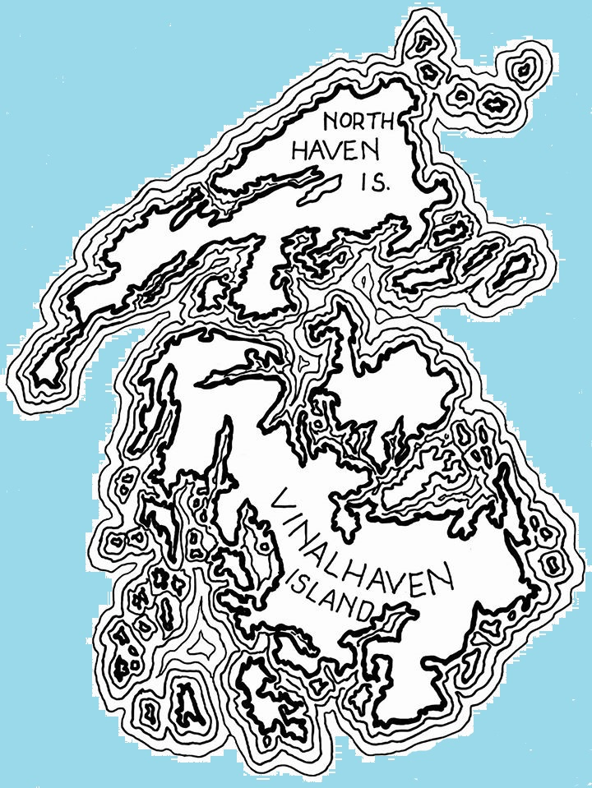
Executive Summary
Installation of three 1.5 Megawatt GE Wind Turbines to decrease electricity costs for island residents
Project Objective:
Scope Management Process:
Plan Scope Management
Collect Requirements
Define Scope
Create Work Breakdown Structure (WBS)
Notes:
The Fox Islands of North Haven and Vinalhaven are located in Maine’s Penobscot Bay, 12 miles offshore of the city of Rockland. Residents of the island purchase electricity from the Fox Islands Electric Cooperative, a community-owned transmission and distribution cooperative established in 1974. In 2001 the Fox Islands Electric Cooperative began exploring the possibility of wind power to supply electricity to the island, and the shift in political climate by 2008 towards more green, renewable energy options served as a catalyst for developing the Fox Islands Wind Project. The ultimate objective of the project is to install three 1.5 Megawatt GE wind turbines capable of generating approximately 11,600 Megawatt Hours per year to generate enough energy for the island residents so that energy costs for islanders will decrease by at least 15%. The hope is also that this project will serve as an energy model for other wind projects in Maine and throughout the United States (Lassiter et.al., 2011).
Scope Management is the process of “creating a scope management plan that documents how the project will be defined, validated and controlled (Project Management Institute, 2017, p 134).” Project scope is “the work performed to deliver a product, service, or result with the specified features and functions (Project Management Institute, 2017, p 131)” and is 100% of the work required, and only the work required, to complete a project. It defines what is and is not included in the project work. Project Scope Management for this project included the following critical planning processes: planning scope management, collecting requirements, defining scope, and creating a Work Breakdown Structure (WBS). Project scope management also included developing a project scope statement, a WBS, and a WBS Dictionary which formed a scope baseline for the project. This determines if the project remains in budgeted time, cost, and resource estimates and allows the project team to identify changes to the project scope. Additionally, the scope management plan includes a plan for how change requests to the scope of the project will be managed. Tools and techniques used to develop the project scope included expert judgement, data gathering and analysis, stakeholder interviews, meetings, and review of historical information in the organizational process assets as well as taking under consideration any other enterprise environmental factors. (Project Management Institute, 2017, p 136).

Slide 3
Requirement Collection and Tools
Requirements | Collection Tool
Feasibility Studies | Observation & Collection Workshops
Community Support | Focus Groups, Surveys & Town Hall Meetings
Site Reviews | Observation, Collection Workshops
Noise Requirements | Observation, Focus Groups
Economic Modeling | Interviews
Financing | Interviews
Notes:
The listed requirements for the Fox Islands Wind Project are a necessity to obtain the project goals within the scope while addressing the needs of the community in order for the project to be a success. There are many ways to collect a project’s requirements. “Requirements elicitation (or collection) and analysis is the iterative work to plan, prepare, and conduct the elicitation of information from stakeholders (Project Management Institute, 2015, p 69).” There are several techniques to draw out information from stakeholders and other sources, each with their own set of benefits and risks.
For the requirement of a Feasibility Study, the observation tool and conducting collection workshops were used to collect data and show evidence of combining wind turbines and diesel generators to lower electricity costs on the Fox Islands from $0.314 to $0.262 per kWh. (Manwell et.al., 2003, p. 9).
The requirement of Community Support was collected by using the Fox Islands Electric Cooperative as a focus group to represent the islanders’ support of the project and vote for its implementation on the island as well as conducting Town Hall meetings with the Island residents and disseminating surveys and questionnaires. A majority voting result of at least 195 approving votes from the members of Fox Islands Electric Co-Op (FIEC) was required in order to proceed with the subsequent plans to build the turbines (Lassiter et.al., 2011, p. 6).
Site Reviews were a requirement due to the need to find the proper space of a 26-acre site to build the 400 ft tall 1.5 MegaWatt Vinalhaven turbine structures on the Fox Islands under the U.S. Department of Energy Standards (Lassiter et.al., 2011, p.14). The tool used for this was the observation of the most feasible areas of the islands as well as conducting collection workshops with stakeholders.
The Noise Requirements were needed to make sure Fox Islands Wind LLC would maintain good standing with the community by assuring that the “sound from the turbines’ routine operations shall not exceed the Maine Department of Environmental Protection Noise Requirements of 75 dBA at any time of day by studying the variation of wind turbine noise after its implementation” (Lassiter et.al., 2011, p.20). The collection tools used for this was the observation of the wind turbine noise as well as community focus groups to gather resident sentiment.
Economic Modeling was a requirement needed to secure $14.5 million in funding from tax equity investors and government-sponsored financing towards the project subject to the agreed-upon rate of return (Lassiter et.al., 2011, p. 11). The collection tool needed for this requirement was interviewing prospective investors to then propose the idea of a funding opportunity.
Financing was an essential requirement in which the Fox Island Electric Co-op must secure a total of $14.5 million to cover the costs of pre-development, GE Turbines, construction and property, and escrow (Lassiter et.al., 2011, p. 13). The collection tool used was interviewing the Rural Utilities Service to gain a better understanding of their financing opportunity and this option worked best for this project’s scope (Lassiter et.al., 2011, p. 11).

Slide 4
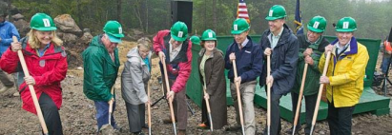
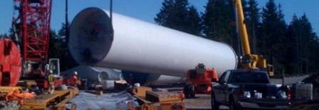
Project Scope Statement
Business Requirements
Solution Requirements
Exclusions
Project Constraints
Assumptions and Risks
Approvals
Notes:
The scope statement ensures that the project scope is defined accurately and is important to the project’s success as it increases the accuracy of cost, time, and resource estimates. As mentioned previously, the scope statement provides a baseline for project performance and controls (Schwalbe, 2017), and is crucial to ensuring a common understanding of the scope of the project exists between stakeholders (Project Management Institute, 2017, p 154). In addition to outlining what work is to be included in the scope of the project, the detailed scope statement also includes exclusions to the scope and helps the project team distinguish scope development and changes from scope creep (Kraus, 1992). The project scope statement for the Fox Islands Wind Project contains a comprehensive outline of the scope components which includes: Business Requirements, Solution Requirements, Exclusions, Project Constraints, Assumptions and Risks, and Approvals.
A requirement is “a condition or capability that is necessary to be present in a product, service, or result to satisfy a business need (Project Management Institute, 2017, p 82).” Collecting these requirements is the process of determining, documenting, and managing stakeholder needs and requirements to meet objectives. The key benefit of this process is that it provides the basis for defining the project scope (Project Management Institute, 2017, p 138). Requirements also become the foundation for the Work Breakdown Structure (Project Management Institute, 2017, p 140).
Business requirements include those items that are essential to fulfilling overall organizational goals. These included a three-year feasibility study to measure wind speeds at the proposed site for the wind turbines, securing at least 195 approving votes from the members of the Fox Island Electric Co-Op, ensuring that the sound from turbines’ routine operation shall not exceed the Maine Department of Environmental Protection Noise Requirements of 75 dBA at any time of day, securing $14.5 million from tax equity investors and government-sponsored financing to cover the costs of pre-development, GE Turbines, construction and property, and escrow (Lassiter et.al., 2011).
Solution Requirements describe features, functions, and characteristics of the product, service, or result that will meet the business and stakeholder requirements (Project Management Institute, 2017, p. 148).” These include developing a site that will produce between 6.5 meters/second at 80 meters of winds speed to produce an adequate power output under the U.S Department of Energy Standards while lowering the costs of residential energy usage (Lassiter et.al., 2011), building three 1.5 megawatt wind turbines capable of producing 11,600 MWh per year, securing $5 million from a local tax incentive investor, Diversified Communications to help fund the overall costs of building the turbines, securing at least a $1.5 million construction loan towards funding the down payment to GE for constructing the turbines, reducing the wind turbine noise to 50 db(A) at nighttime to alleviate the noise complaints of nearby residents, and solidifying and maintaining community support from the majority of Co-op members (over 50%) throughout the duration of project.
Exclusions are the identified activities or work that are not included in the scope of the project. Items not in the scope of work for this project are securing funding for noise mitigation after the project has been completed, recurring maintenance and post construction expenses, and any necessary alterations due to changes in government regulations or tax credit policies.
Project Constraints are “any limitations on the [project] team’s options to execute the project (Project Management Institute, 2015, p. 30).” Constraints identified for this project include: securing sufficient funding to support the purchase of the turbines and cover all costs for construction and materials, construction expenses and timeline limited by the project’s location, site feasibility since wind turbine power is a cubic function of wind speed, small changes to wind speed could drastically affect the power output, turbine availability as the project must purchase turbines on the open market, and continued community support since a majority vote is needed to see the project through to its completion.
An assumption is “any project factor that is considered to be true, real, or certain without empirical proof or demonstration (Project Management Institute, 2015, p 30).” Assumptions can be proven to be either true or false during the work of the project and “while assumptions may not hold true over the course of the entire project, they impose a level of risk (Project Management Institute, 2015, p 121).” A risk is an event or condition that, if it occurs, could have a positive or negative effect on a project’s objectives (Project Management Institute, 2015, p 395).
Approvals indicate the list of individuals that have reviewed the documented scope of the project and have given their acceptance of the scope baseline Any changes to the scope of the project must be coordinated and approved.

Slide 5
Assumptions and Risks
Assumptions
Risks
Reduced turbine noise
Improved energy costs
Minimal disturbances
Sufficient community support
Available equipment & materials
Consistent project team
Sufficient funding
Community concerns
Delayed permits
Construction delays
Insufficient funding
Government policy changes
Reduced tax incentive
Unreliable grid
Notes:
There are many assumptions and risks outlined in the project’s scope statement including that the wind turbines will be quiet, that the wind power will improve energy costs for island residents, that there will be enough community support to complete the project, that equipment and materials will be available when needed, all project team members will remain on the project until completion, and that enough funding will be available to fund the project in its entirety.
Risks associated with this project include that residents have several concerns which may lead to the community rejecting or delaying the project, permit approvals may take longer than expected, the price of wind turbines may increase, there may be delays in equipment acquisition and delivery, the project may experience construction delays due to issues with ferry availability, inability to fully fund the project or increased construction costs, government regulations may change, tax incentives may be reduced or revoked, the Mainland grid connection may be unreliable, and wind turbines may pose a threat to aviation safety.
Assumptions can be proven to be either true or false during the work of the project and “while assumptions may not hold true over the course of the entire project, they impose a level of risk (Project Management Institute, 2015, p 121).” Risks are identified and analyzed on an ongoing basis and updated in the Risk Management Plan and Risk Register. Depending on the risk’s characteristics, the project team will choose the appropriate risk work approach and the effective tools to either eliminate or mitigate the risk.

Slide 6
Work Breakdown Structure
The Fox Islands
Wind Project
Level 1
Project
Level 2
Major Deliverables
1.0
Project Initiation
2.0
Project Planning
3.0
Project Execution
4.0
Monitoring & Controlling
1.1 Project Charter
2.1 Project Integration Management
3.1 Assessments
4.1 Schedule Control
Level 3
Sub-Deliverables
1.2 Project Kickoff Meeting
2.2 Project Scope Management
3.2 Financing
4.2 Scope Control
2.3 Project Schedule Management
3.3 Site Preparation
4.3 Cost Control
2.4 Project Cost Management
3.4 Equipment Acquisition
2.5 Project Quality Management
3.5 Construction
2.6 Project Resource Management
Notes:
The Work Breakdown Structure created for the Fox Islands Wind Project shows all of the major deliverables and sub-deliverables required to complete the project. This WBS follows the 100% rule in that all activities and deliverables required to complete the project are listed and all activities and sub-deliverables listed correspond to the major deliverables (no listings fall outside of scope). In order to check the accuracy of the WBS, the team worked backwards with a bottom-up approach starting at the Level 4+ activities, asking “If all of these were completed, and only these activities, will each sub-deliverable be completed?” If the team completed all sub-deliverables, will each major deliverable be completed? If the team completed all major deliverables, will the project be completed? Since the answer was “Yes” to all of these questions, the WBS is complete.
The WBS was created as a deliverable-based WBS rather than a phased-based WBS. Each sub-deliverable and activity is unique to their major deliverables. Each step is tangible and is listed as a noun to identify what needs to be completed. A phased-based WBS would use verbiage to indicate how steps would get done as well as the chronological order within each phase. Because of the tangibility of each activity the team needs completed, a deliverable-based WBS is appropriate (Colenso, 2000).
This slide provides a sample of the larger WBS which has 5 Level 2 major deliverables, 23 Level 3 sub-deliverables, and 41 Level 4+ activities.
Level 4 activities are not shown here, but for example with 3.1, the activities needed to complete all Assessments would be:
3.1.1 Feasibility Study
3.1.2 Site Assessment
3.1.3 Wind Assessment / Testing
3.1.4 Environmental Assessment / Testing
3.1.5 Community Assessment
3.1.6 Financing Assessment
Overall, the Work Breakdown Structure provides the team with an easily readable, hierarchical chart, that clearly identifies all aspects of the project that are within scope.

Slide 7
Project Scope Change Control Process
Evaluate Change
2. Prepare for Change
3. Plan for Change
George Baker defines the Scope Change Request
He submits the Change Request and the Change Control Board reviews the Change Request
The CCB defines change options and responds
The CCB summarizes the change impact
The CCB decides, accepts, rejects or defers
George Baker documents the change
He updates the project baseline
He communicates the change to the stakeholders
(Gray, n.d.)
Notes:
Formally managing changes to scope are critical to this project in order to prevent cost overruns and schedule delays as a result of unanticipated or miscommunicated changes to the scope of the project. To reduce unanticipated scope change known as scope creep for this project, Project Manager George Baker manages project changes by defining the scope change request. Then, he submits the request form to the stakeholders on the Change Control Board (CCB) for review. The board consists of Dave Folce, the General Manager of the FEIC, the General Manager of Cianbro Construction, and Marjorie Stratton, the Vinalhaven Town Manager.
The CCB defines the change options and responds to George Baker with their thoughts on the change request. The group of stakeholders will provide what type of impact the change will make and then decide, accept, reject or defer the change request. Then, if the change is accepted by the Change Control Board the change is then documented and the scope baseline on the WBS is updated and then the change is communicated to all of the project stakeholders.

Slide 8




Scope Trade-Offs
Construction Capacity
Turbines
Community Support
Site Design
Notes:
Before determining possible scope trade-offs if the project goes over budget or schedule, there are two factors that the project cannot compromise on. As shown in blue, the project cannot compromise on community support or construction capacity. The project’s purpose is to reduce the electricity costs of Fox Islands residents so disrupting their lives to build a project that does not save them electricity is unethical. The community is also crucial because they make up the Cooperative so they have large influence and impact over the project. Any changes to the project scope that affect the residents negatively or are not in their best interests are unacceptable. Because the Fox Islands are small and isolated, the current construction plan already extends the patience and capabilities of the islands. The construction and delivery of the turbines and parts are limited by the size of the island and the ferry or barge access to and from the island. Additionally, the construction company will disturb the residents so there is no room for the construction company to add more workers without overwhelming the islands’ capacities. Any scope changes that try and increase the capacity cannot be tolerated.
There is one minor and one major scope trade-off that would be accepted under the right circumstances. First, the site design could be modified to reduce the construction cost or shorten the completion date. Instead of building wide, well-lit, paved access roads, the project could reduce the number of lights or make the roads out of gravel or dirt. These would be simple fixes that do not affect the electricity output and would have very minimal impacts on the project overall. A major trade-off would be reducing the number of turbines in the project from 3 to 2. Project funding sources could pull back or GE could have trouble producing enough turbines and make turbine acquisition difficult. If possible, and confirmed by the many studies listed in the Work Breakdown Structure, 2 turbines could still produce enough electricity to reduce the residents’ electricity costs. This trade-off, however, would reduce their savings and increase the amount of time it takes to pay off the debt. This trade-off should only be considered as a last resort with significant resident approval.
The project already has a tight budget with many creative funding sources and very little leverage to get other funding. If funding were impacted, the project would be forced to decrease construction costs in the short term and spread out the project over a longer period. A smaller construction crew would cost less but take longer to complete the project. The extra time would also allow the project to find another funding source, if possible.

Slide 9

Thank you!
9

Slide 10
References:
Colenso, K. (2000). “Creating The Work Breakdown Structure.” Work Breakdown Structure - An Introduction. Artemis Management Systems. http://www.exclusive-pm.ru/files/625/wbs.pdf.
Fox Islands Electric Cooperative, Inc. (2021). History and Energy Sources. Accessed via https://www.foxislands.net/
Gray. (n.d.). Modules 4 & 5 Instructor Perspective [Slide show; Video]. Canvas. https://northeastern.instructure.com/courses/126473/pages/module-5-instructor-perspective?module_item_id=7471296
Kraus, W.E., & Cressman, K.R. (1992, December). Project Scope Definition: A Practical Approach. Cost Engineering; 34, 12; ProQuest One Academic.
Lassiter III, J.B., Corcoran, J., Gazor, M., Hogarty, D., Somers Jr., A.H. (2011, February 15). The Fox Islands Wind Project (A). Boston, MA: Harvard Business School Publishing.
Manwell, J. F., McGowan, J. G., & Blanco, G. (2003). Wind/Hybrid Power System Applications for New England Islands. Wind Engineering, 27(2), 143–155. https://doi.org/10.1260/03095240360698582.
Project Management Institute, Inc., (2015). Business Analysis for Practitioners: A Practice Guide. Newton Square, PA: Project Management Institute, Inc.
Project Management Institute, Inc., (2017) A Guide to the Project Management Body of Knowledge (PMBOK Guide). (6th ed.). Newton Square, PA: Project Management Institute, Inc.
Schwalbe, K., (2017). An Introduction to Project Management (6th ed.). Minneapolis, MN: Schwalbe Publishing.

